Slide 1
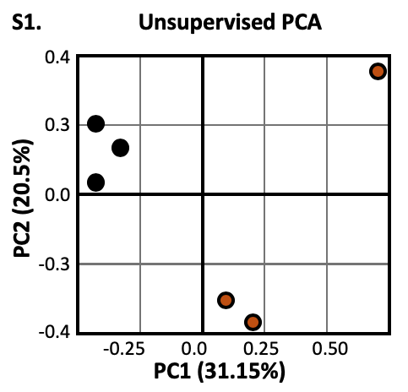
Supplementary Figure S1
Supplemental Figure S1: Unsupervised two-dimensional principal component analysis using normalized microarray beta values. Black circles (βPRLRKO); Red circles (CON).

Slide 2
Supplementary Figure S2
(a)
(b)
Supplemental Figure S2: (a) Body weight (grams) of βPRLRKO mice and littermate controls (CON) at baseline (t = 0) and following twelve weeks of standard chow (chow) or 60% HFD feeding (n = 6). (b) Intraperitoneal glucose tolerance testing and area under the curve (AUC) of HFD and chow-fed mice.

Slide 3
(a)
Supplementary Figure S3
(b)
KEGG Pathway | Genes | FDR
Fatty acid metabolism | CPT1A|ACAT1|FADS2|ACAA2| SCD5|FADS1|ACSL4|ACADVL| ACSL3|ACADSB|SCD | 3.93E-09
PPAR signaling pathway | CPT1A|SLC27A2|FADS2|ANGPTL4| LPL|SCD5|ACSL4|ACSL3|HMGCS2| SCD|RXRB | 1.07E-07
PI3K-Akt signaling pathway | GNB4|CDKN1A|GNB5|COL6A3|ITGB1| COL3A1|ANGPT2|F2R|FGF1|EIF4EBP1| THBS2|CRTC2|ITGA10|GNG12|MYC| GNG7|COL4A3|RELN|LAMA2|TNXB | 8.73E-07
Valine, leucine and isoleucine degradation | OXCT1|ACAT1|ABAT|ACAA2|ALDH9A1| ACADSB|HMGCS2|ALDH6A1 | 3.61E-06
Fatty acid degradation | CPT1A|ACAT1|ACAA2|ACSL4|ALDH9A1| ACADVL|ACSL3|ACADSB | 3.61E-06
Supplemental Figure S3. (a) Protein-protein interaction network of RNA-sequencing dataset generated by Cruciani et al. (PMID: 28377873) of 30-day HFD for the C57BL/6J mice (n = 6) relative to normal chow-fed mice. (b) Gene set enrichment analysis of the protein-protein interactome using the KEGG pathway database, reporting the top-5 most enriched pathways.

